Slide 1
ELISA
Enzyme Linked Immunosorbent Assay

Slide 2
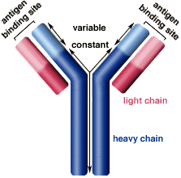
Definitions
Antibodies (also known as immunoglobulins abbreviated Ig) are gamma globulin proteins that are found in blood and are used by the immune system to identify and neutralize foreign objects, such as bacteria and viruses.

Slide 3
Definitions- cont
Antigens
A substance that when introduced into the body stimulates the production of an antibody
Immunoassay
A laboratory technique that makes use of the binding between an antigen and its homologous antibody in order to identify and quantify the specific antigen or antibody in a sample

Slide 4
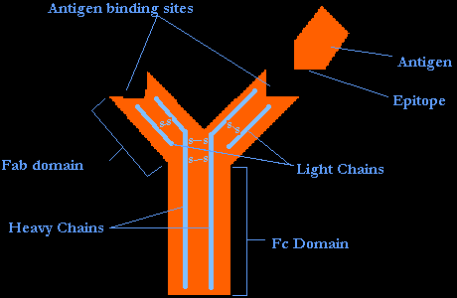

Slide 5
Definitions- cont
Analyte
The sample being analyzed and in immunoasssays the analyte is either Antibody or Antigen

Slide 6
Antigen
Is present naturally in the body like hormones
Is manufactured in special disease status for example human chorionic gonadotrophin hormone (HCG) which is normally produced by cells of the placenta in pregnancy is found in the body in some types of cancer
Is not present in the body in normal condition like drugs

Slide 7
Introduction
The Antibody: An immunoglobulin, a specialized immune protein, produced because of the introduction of an antigen into the body, and which possesses the remarkable ability to combine with the very antigen that triggered its production (specific affinity)
The antibody recognises and bind to the antigenic determinant region of the antigen

Slide 8
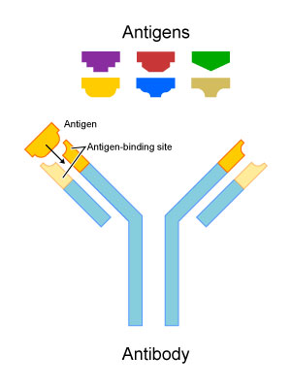

Slide 9
Antibody Production
Specific antibodies are produced by injecting an antigen into a mammal, such as a mouse, rat or rabbit for small quantities of antibody, or goat, sheep, or horse for large quantities of antibody. Blood isolated from these animals contains polyclonal antibodies—multiple antibodies that bind to the same antigen—in the serum, which can now be called antiserum.

Slide 10
Antibody Production-cont
To obtain antibody that is specific for a single antigen, antibody-secreting lymphocytes are isolated from the animal and immortalized by fusing them with a cancer cell line. The fused cells are called hybridomas, and will continually grow and secrete antibody in culture. Single hybridoma cells are isolated by dilution cloning to generate cell clones that all produce the same antibody; these antibodies are called monoclonal antibodies

Slide 11
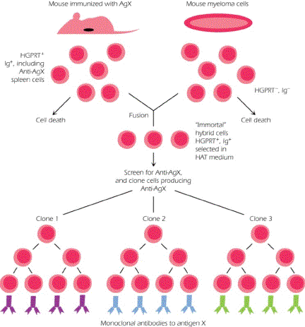

Slide 12
ELISA technique
Is a biochemical technique used mainly in immunology to detect the presence of an antibody or an antigen in a sample.
The technique is divided into
1- Competitive ELISA
2- Sandwich ELISA (also called direct ELISA)
3- Indirect ELISA

Slide 13
Competitive ELISA
The labelled antigen competes for primary antibody binding sites with the sample antigen (unlabeled). The more antigen in the sample, the less labelled antigen is retained in the well and the weaker the signal).

Slide 14
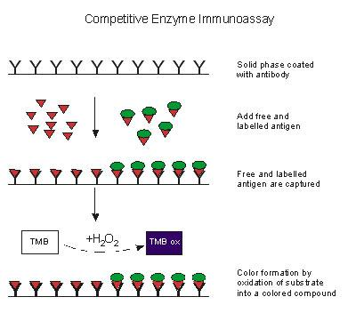

Slide 15
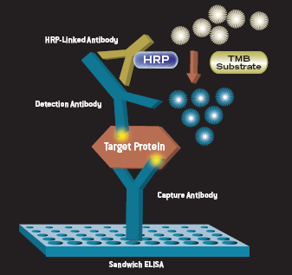
Sandwich ELISA
The ELISA plate is coated with Antibody to detect specific antigen

Slide 16
Sandwich ELISA
Prepare a surface to which a known quantity of capture antibody is bound.
Block any non specific binding sites on the surface
Apply the antigen-containing sample to the plate.

Slide 17
Sandwich ELISA-Cont
Wash the plate, so that unbound antigen is removed.
Apply enzyme linked primary antibodies as detection antibodies which also bind specifically to the antigen.
Wash the plate, so that the unbound antibody-enzyme conjugates are removed.

Slide 18
Sandwich ELISA-Cont
Apply a chemical which is converted by the enzyme into a coloured product.
Measure the absorbency of the plate wells to determine the presence and quantity of antigen

Slide 19
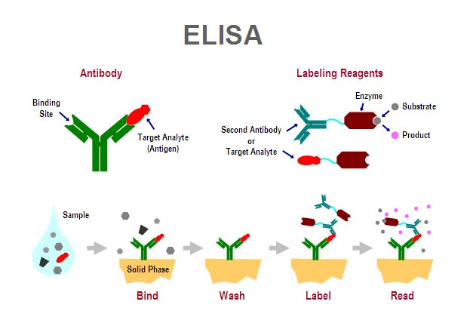
Sandwich ELISA

Slide 20
Indirect ELISA
The protein antigen to be tested for is added to each well of ELISA plate, where it is given time to adhere to the plastic through charge interactions
A solution of non-reacting protein is added to block any plastic surface in the well that remains uncoated by the protein antigen

Slide 21
Indirect ELISA-Cont
Then the serum is added, which contains a mixture of the serum antibodies, of unknown concentration, some of which may bind specifically to the test antigen that is coating the well.
Afterwards, a secondary antibody is added, which will bind to the antibody bound to the test antigen in the well. This secondary antibody often has an enzyme attached to it

Slide 22
Indirect ELISA-Cont
A substrate for this enzyme is then added. Often, this substrate changes colour upon reaction with the enzyme. The colour change shows that secondary antibody has bound to primary antibody, which strongly implies that the donor has had an immune reaction to the test antigen.
The higher the concentration of the primary antibody that was present in the serum, the stronger the colour change. Often a spectrometer is used to give quantitative values for colour strength

Slide 23
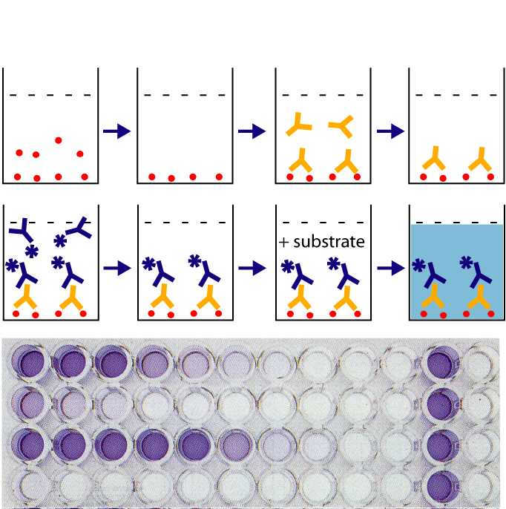
Indirect ELISA

Slide 24
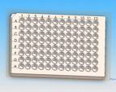
An example of an ELISA experiment
Before starting the work read kit instruction carefully
1- The 96 well plate is labeled carefully and the first wells are used to draw the standard curve

Slide 25
An example of an ELISA experiment-Cont
The sample is added to plate in duplicate or triplicate and then the mean result is calculated
The quality control sample which is provided with the kit is treated as the test samples

Slide 26
Results
After reading the results the standard curve is drawn were the concentration is blotted on the X-axis and the absorbance on the Y-axis
Absorption nm
Concentration ng/ml

Slide 27
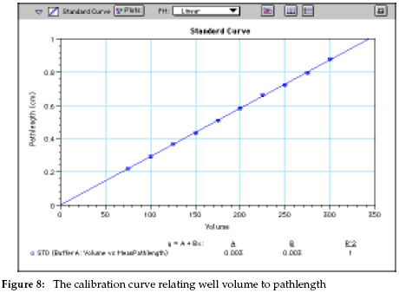
Results-cont
The standards concentrations is specified on the x-axis and the reading of each standard is specified on the y-axis and the standard curve is drawn

Slide 28
Results-cont
This standard curve is used to determine the unknown concentration of each sample by finding the opposite concentration to the absorbance
Absorption nm
Concentration ng/ml

Slide 29
Results-cont
The quality control sample concentration is determined from the standard curve and if the result is in the range given by the kit manufacturer the results could be accepted

Slide 30
Useful sites
http://www.edumedia-sciences.com/en/a543-direct-enzyme-linked-immunosorbent-assay-elisa
ELISA
http://www.sumanasinc.com/webcontent/animations/content/ELISA.html
http://www.biology.ualberta.ca/facilities/multimedia/uploads/procedures/elisa-sound.swf

